Slide 1
Deadlock: Part II

Slide 2
Reading Assignment
T. M. Pinkston, “Deadlock Characterization and Resolution in Interconnection Networks,” Chapter 13 in Deadlock Resolution in Computer Integrated Systems, CRC Press 2004
V. Puente et.al, “Adaptive Bubble Router: A Design to Improve Performance in Torus Networks,” Proceedings of the 1999 International Conference on Parallel Processing

Slide 3
Deadlock: A Closer Look
Deadlock conditions arise from more than just routing packets, e.g., routing induced deadlock
  Just making use of the topology in a deadlock free manner is insufficient
Other solutions to deadlock freedom beyond strictly guaranteeing avoidance
  Recovery vs. avoidance

Slide 4
Types of Deadlock
Routing induced
  Created by the routing function
  This is what we have studied so far, but are there weaker solutions?
Message induced
  Addition of dependencies to an existing routing function via message type dependencies at the end-points
Reconfiguration induced
  Addition of dependencies when transitioning (reconfiguration) from one routing function to another

Slide 5
Closer Look at Routing Induced Approaches
Deadlock freedom in the wide sense
  Strict avoidance + routing freedom → Duato’s protocol
Deadlock freedom in the weak sense
  Permitted resources (cycle or knot) are never filled
    Injection limitation and bubble flow control
    Two-phase routing protocols
      Circuit switched and PCS networks
  Deflection routing
    SAF and VCT only

Slide 6
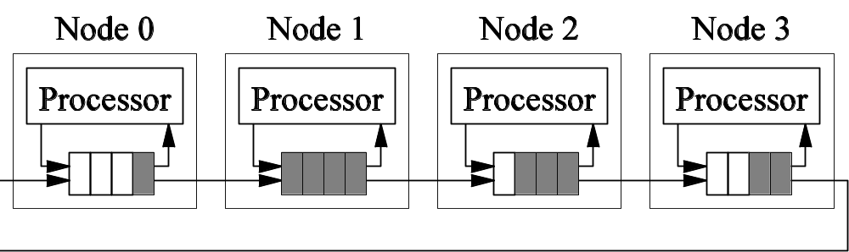
DA via Injection Limitation
Key to deadlock avoidance is guaranteeing forward progress
What if we ensured there would always be at least one buffer in any cycle?
  Injection limitation at sources → O(PxM) buffers/NI
For SAF and VCT only
Many ways to ensure the bubble condition

Slide 7
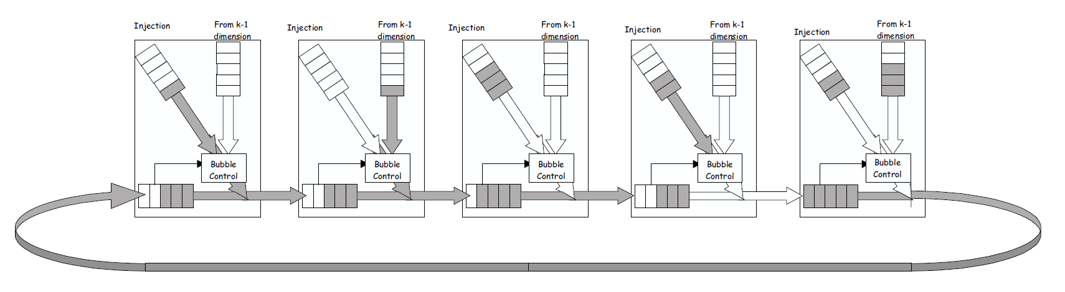
Bubble Flow Control
Packet injection requires two free packet buffers
  One empty buffer left after injection
Selection function is biased towards adaptive channels
From V. Puente et.al, “Adaptive Bubble Router: A Design to Improve Perfomance in Torus Networks,” Proceedings of the 1999 International Conference on Parallel Processing

Slide 8
Extension to Multiple Dimensions
Dimension traversal is treated as an injection
Bubble flow control only applied to escape channels
Priority is given to traversal over injection
  Traversal to a new dimension must meet buffer requirements
From V. Puente et.al, “Adaptive Bubble Router: A Design to Improve Perfomance in Torus Networks,” Proceedings of the 1999 International Conference on Parallel Processing

Slide 9
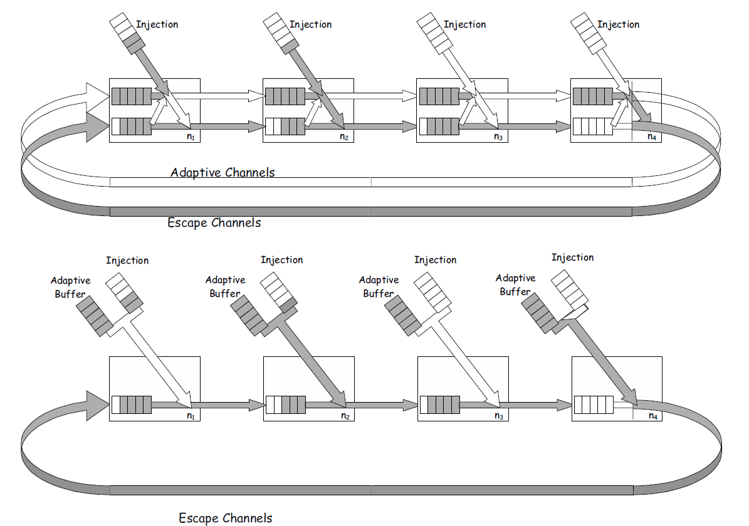
Behavior Under Load
Behave as in a deterministically routed network

Slide 10
Some Consequences
Number of VCs required for deadlock free routing reduced to 1
Number of VCs required for fully adaptive routing is 1
Flow control overhead is less in VCT routers
Simple fast routers
  Applicable only to VCT and Packet switched routers

Slide 11
Deflection Routing
Never hold resources
Problem is Livelock
Prevent cycle dependencies from being sustained
  Packet eventually gets to the head of the queue

Slide 12
Types of Deadlock
Routing induced
  Created by the routing function
  This is what we have studied so far, but are there weaker solutions?
Message induced
  Addition of dependencies to an existing routing function via message type dependencies at the end-points
Reconfiguration induced
  Addition of dependencies when transitioning (reconfiguration) from one routing function to another

Slide 13
Message Induced Deadlock
Consider that message types have dependencies between them
  For example, request → reply
  Dependencies are manifested at the end points
Message sequences utilize resources
Message type dependencies are transferred to resource dependencies
  Message dependencies or protocol dependencies
  Remember the consumption assumption

Slide 14
Directory-Based Coherence Protocols
Local node generates a memory reference
Remote node has a copy of block
P + C
P + C
Generating the request
Dir
Dir
Memory
Memory
Network
Observe the message sequence between local, remote and home nodes
P + C
Dir
Memory
Home node is the physical memory location of a memory reference

Slide 15
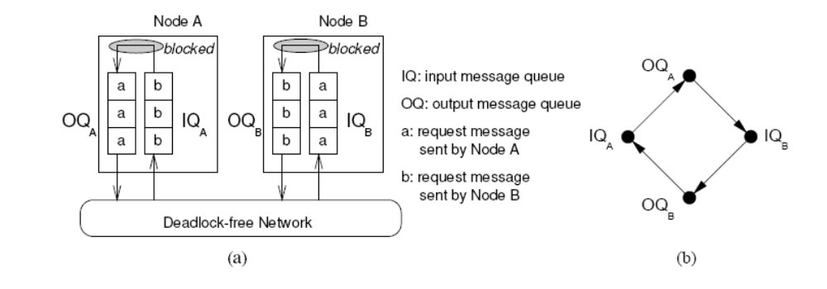
Message Induced Deadlock: Example
Consider the chain of dependencies between message types required to implement a transaction
Key: dependencies prevent consumption!
From T. Pinkston, Chapter 13: Deadlock Resolution in Computer Integrated Systems,” Macel Dekker(pubs), M. C. Zhou and M. P. Fanti (eds), 2004

Slide 16
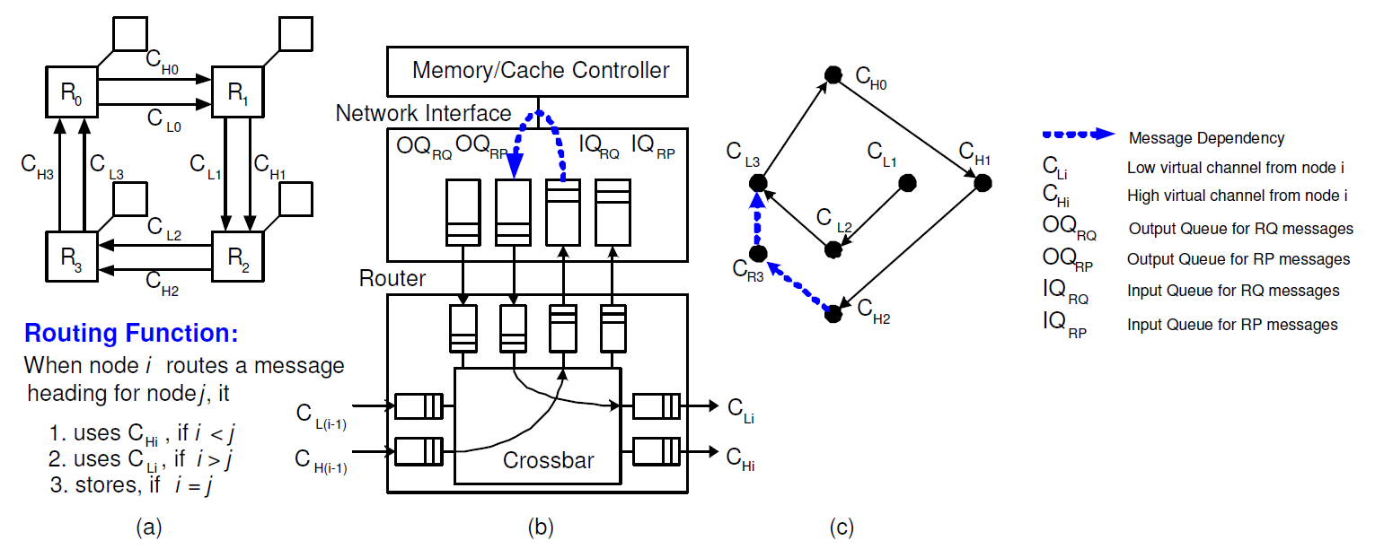
Message Induced Deadlock: Example
Consider the request-reply sequence from R1 → R3
From T. Pinkston, Chapter 13: Deadlock Resolution in Computer Integrated Systems,” Marcel Dekker(pubs), M. C. Zhou and M. P. Fanti (eds), 2004

Slide 17
Message Induced Deadlock Avoidance
Deadlock Free in the weak sense
  Knots/cycles exist but are never filled
  Size total buffer space at end points – O(PxM) buffers at each node
Separate message types by resource usage
  Use virtual networks to avoid cycles
  This can get expensive

Slide 18
Using Virtual Networks for Avoidance
RQ & Reply
RQ/Reply
OUT
IN
RQ & Reply
OUT
IN
OUT
Reply
IN
IN
OUT
IN
RQ
IN
RQ
RQ
OUT
OUT

Slide 19
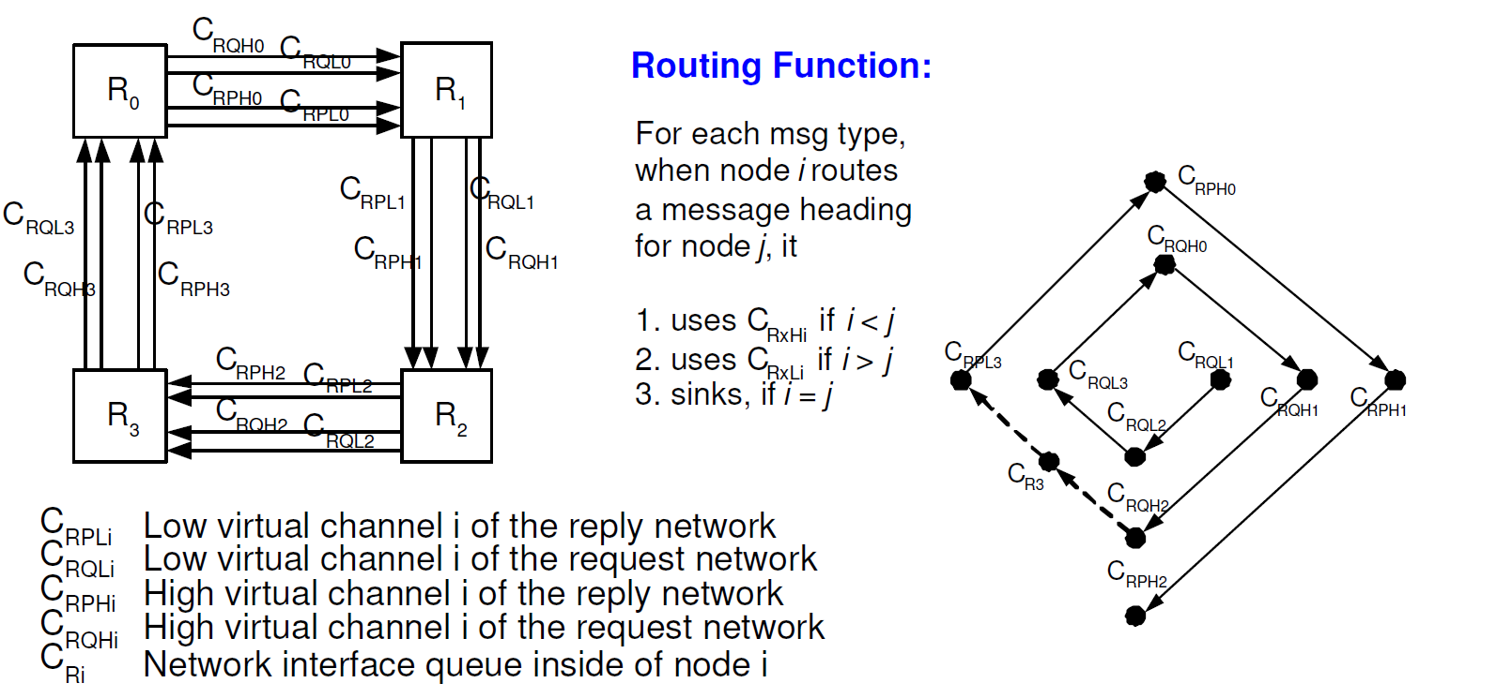
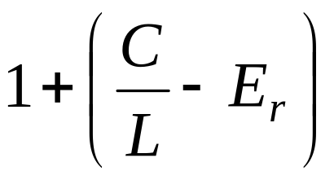

Using Virtual Networks for Avoidance
Total #VCs/channel
Minimum #VCs for avoiding routing induced deadlock
Note:
Message dependency chain length

Slide 20
Types of Deadlock
Routing induced
  Created by the routing function
  This is what we have studied so far, but are there weaker solutions?
Message induced
  Addition of dependencies to an existing routing function via message type dependencies at the end-points
Reconfiguration induced
  Addition of dependencies when transitioning (reconfiguration) from one routing function to another

Slide 21
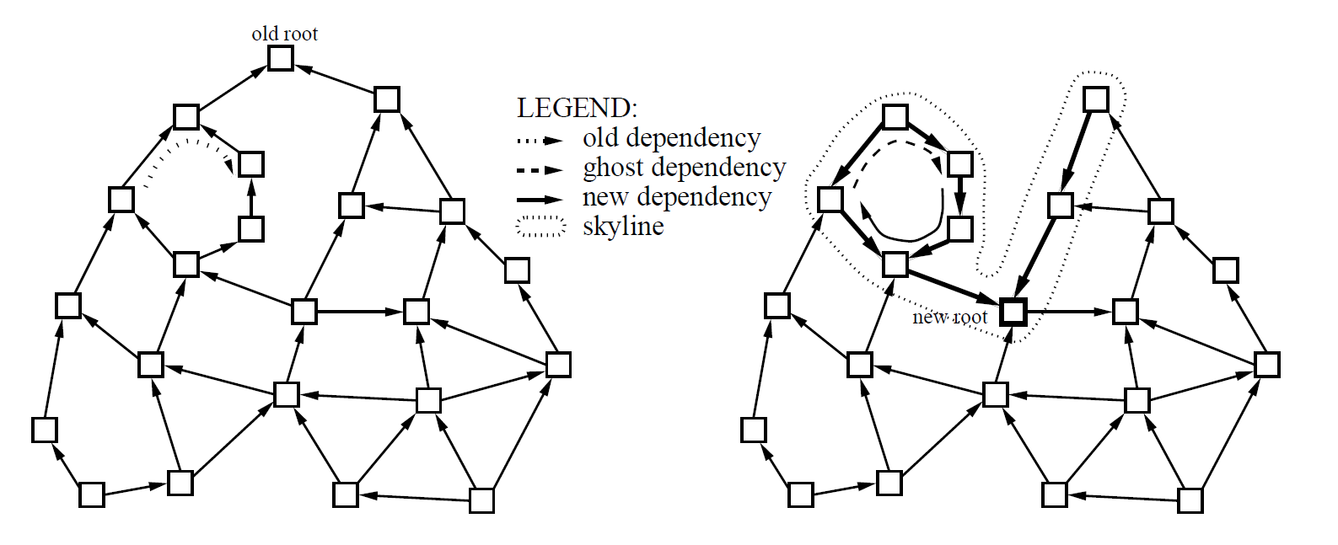
Reconfiguration Induced Deadlock
Messages are routed under two different routing functions
Produces ghost dependencies
From T. Pinkston, Chapter 13: Deadlock Resolution in Computer Integrated Systems,” Marcel Dekker(pubs), M. C. Zhou and M. P. Fanti (eds), 2004

Slide 22
Deadlock Freedom Solutions
Static reconfiguration
  Flush the network
  Update the routing function
  Resume message transmissions relying on upper layer protocols
Dynamic reconfiguration
  Incremental, partial and more difficult
  Packet dropping schemes
  Routing function update schemes
    Partitioned resources such as virtual networks

Slide 23
Deadlock Recovery

Slide 24
Formation of Deadlocked Configurations
Routing Freedom
Topology
Buffer Resources
Packet injection
What are the opportunities to create cycles?
What determines the likelihood that cycles will occur?
  Routing freedom + resources + injection rate
Relationship between hardware complexity and routing function

Slide 25
Approach
Employ recovery mechanisms to break deadlocked configurations of messages
Predicated on the following hypothesis
  Deadlocks are rare → make them rare
  Therefore recovery costs are acceptable
  Recovery is less resource intensive than avoidance

Slide 26
Key Questions
Probability of occurrence
Characterization
On-line detection
Recovery techniques

Slide 27
Probability of Occurrence
Influential factors
  Routing freedom
    Exponential decrease in probability of occurrence
  Number of blocked packets
    Correlated blocking patterns
  Number of resource dependency cycles
    Increases with routing freedom
  Presence of virtual channels
    Reduces the probability of blocking

Slide 28
Characterization of Deadlocks
Deadlock set
  Set of messages that are deadlocked
Resource set
  Set of buffer resources occupied by the deadlocked set
Knot cycle density
  Number of unique cycles within a knot
    Captures complexity of formation of deadlocked message configurations

Slide 29
On-Line Deadlock Detection
Discovery of Cycles
  Typically use some form of flooding protocol
  Exact detection vs. heuristics
Local vs. centralized detection
Use of time-outs
  At nodes with packet headers
    Counter + comparator
  Optimal value depends on message length

Slide 30
Deadlock Recovery Principles
Progressive deadlock Recovery
  Robin hood approach – de-allocate resources from normal packets and assign to the recovery packet
    Remove any message from a deadlocked cycle
    Ensure its progress towards the destination
Regressive deadlock recovery
  De-allocate resources from deadlocked packets
  Typically destroy packets
  Need some recovery mechanism, for example, end-to-end flow control

Slide 31
Trade-offs
Deadlock recovery at the source is typically regressive
  De-allocate and re-inject
Deadlock recovery in the network can be both
  Regressive – propagate de-allocation signals upstream to release resources and abort the packet
  Progressive – re-allocation of resources from normal to deadlocked packets

Slide 32
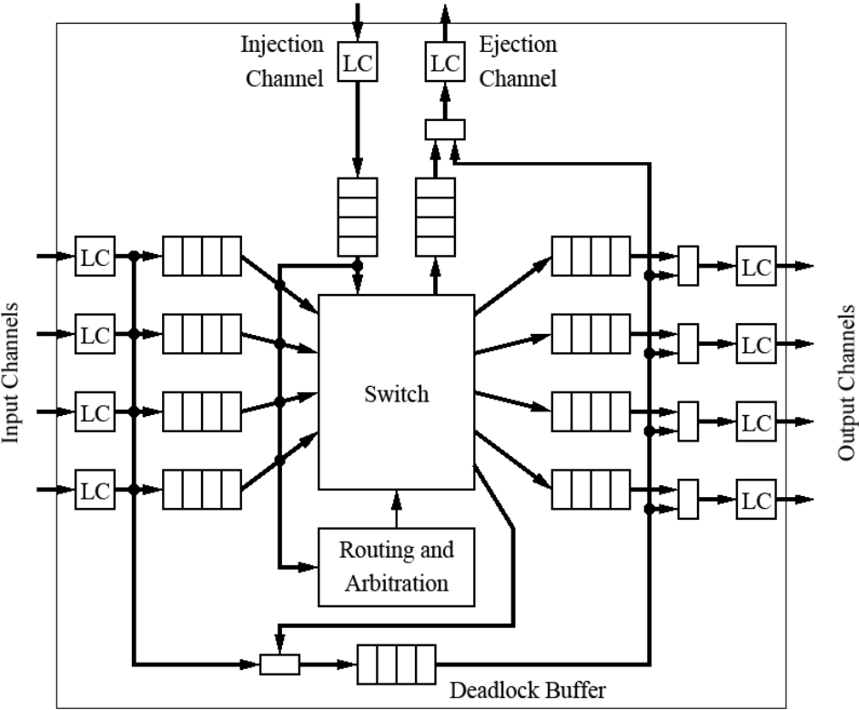
Progressive Deadlock Recovery
Important to be on the output side
Forms the recovery lane across routers
Floating virtual channel can be used by all VCs
Utilized via a separate control path
  Effectively cycle stealing on the physical channels
Use of recovery lanes must be deadlock free

Slide 33
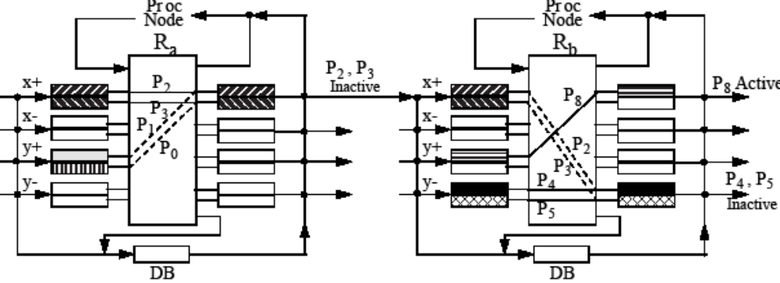
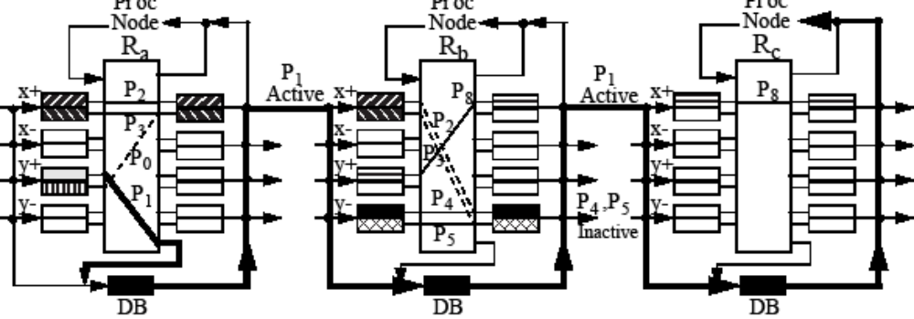
Recovering from Deadlock
control to steal physical channel cycles

Slide 34
Implementation Issues
Number of deadlock buffers
  Impact on crossbar size
Location
  Centralized vs. edge
    Rate at which deadlocked packets can drain
  At the switch output vs. switch input

Slide 35
Optimizations
Sequential progressive recovery
  Only one packet is permitted to enter the deadlock recovery lane
  Mutual exclusion via a circulating token
  Recovery lane implements a connected routing sub-function with no cyclic dependencies
Concurrent recovery
  Hamiltonian path based
  Spanning tree based

Slide 36
Ping and Bubble Scheme
Ping propagation to trace cycles
Bubble insertion to permit progress
Performance issues
  Each insertion will permit forward progress by at least one step
  Routing freedom increases the probability that deadlocks are broken quickly
  Minimal adaptive routing ensures all messages are eventually delivered
Permits True Fully Adaptive Routing

Slide 37
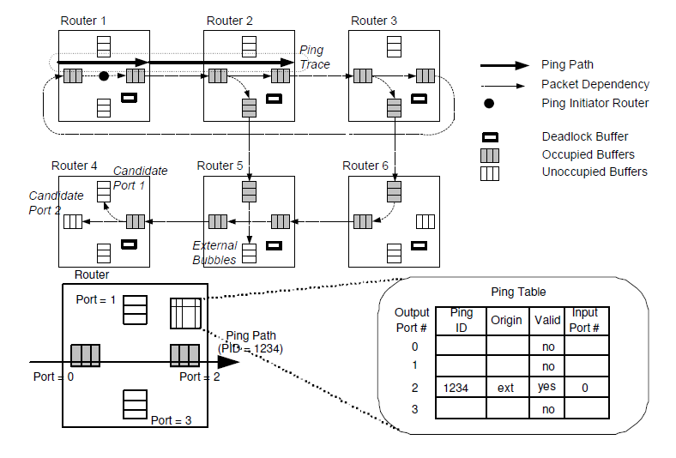
Ping and Bubble Scheme: Example
From T. Pinkston, Chapter 13: Deadlock Resolution in Computer Integrated Systems,” Marcel Dekker(pubs), M. C. Zhou and M. P. Fanti (eds), 2004

Slide 38
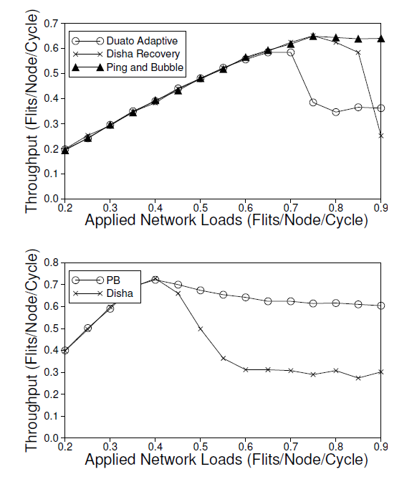
Performance of Recovery Protocols
Extends the range of achievable
performance
Resources devoted to deadlock
management is minimized in
recovery
  more resources available for
  performance enhancement
From T. Pinkston, Chapter 13: Deadlock Resolution in Computer Integrated Systems,” Marcel Dekker(pubs), M. C. Zhou and M. P. Fanti (eds), 2004

Slide 39
Performance Issues
Cyclic non-deadlocks can form
  Extended blocking – “sludgelock”
  Occurs when available routing freedom is being extensively exploited at high loads
Deadlock avoidance places acyclic dependency guarantees before routing freedom
Deadlock recovery emphasizes routing freedom first, and hence can have a performance advantage

Slide 40
Summary
Routing protocols must be designed to be correct
  Applications to fault tolerance and multicast
Recovery vs. Avoidance
  Resource commitment vs. latency impact
Customized solutions can favor recovery

